Slide 1


Apple Stock Price
Forecasting
A Time Series Modeling and Deployment Project
Group 4

Slide 2

Problem Statement:
Stock market prices are highly volatile and influenced by multiple internal and external factors.
Predicting future stock prices accurately is challenging for investors and financial analysts.
Traditional decision-making approaches may lead to financial risks.
There is a need for a reliable forecasting system to support data-driven investment decisions.
Problem Statement
&
Business Objective
Business Objective:
To develop a predictive model that forecasts Apple stock prices for the next 30 days.
To analyze historical stock data from 2012 to 2019.
To compare different time series models and select the best-performing one.
To deploy the final model as a user-friendly web application for real-time forecasting.

Slide 3

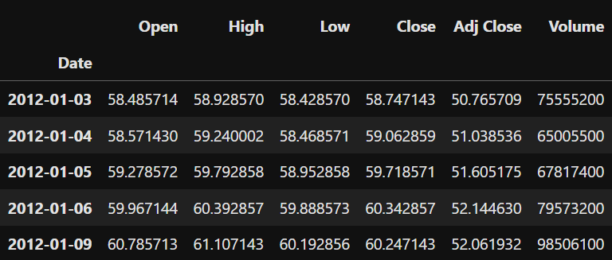
Dataset Overview:
Dataset: Historical Apple stock price data
Time Period: 2012 – 2019
Each record represents the trading activity of a single day.
It allows analysis of seasonality, volatility, and price patterns
Date :
Trading date
Open :
Opening price of the stock on that day
High :
Highest price reached during the day
Dataset Description
Low :
Lowest price reached during the day
Dataset Size:
Close :
Closing price of the stock
Number of rows : 07
Number of columns : 2011
Volume:
Number of shares traded
Target Variable:
The primary target variable is the Closing Price, which is forecasted for the next 30 days.

Slide 4
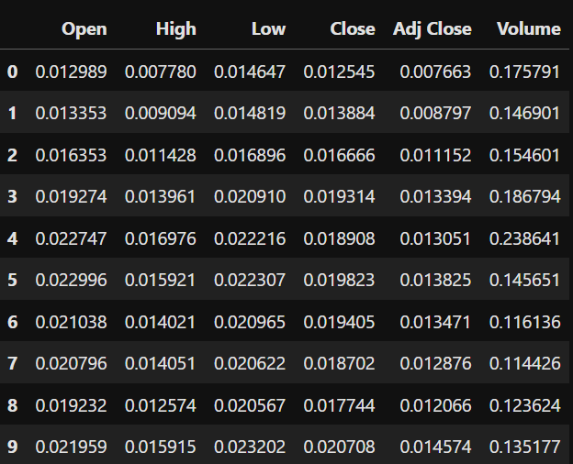
Data Preprocessing & Cleaning
Converted the Date column into datetime format.
Set the Date column as the index for time series analysis.
Dataset contains 2011 rows and 7 columns.
All columns have 2011 non-null values (no missing data).
Data types include numerical (float, int) and date values.
Selected Close price as the target variable.
Applied MinMax Scaling to normalize the data.

Slide 5

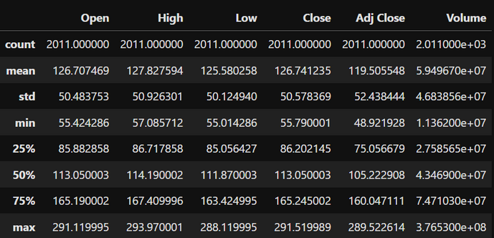
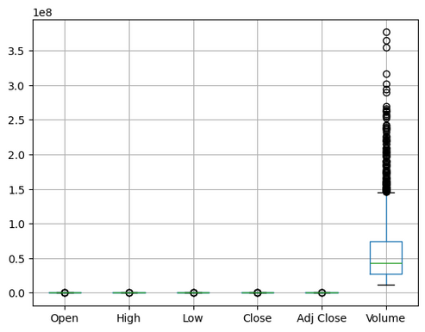

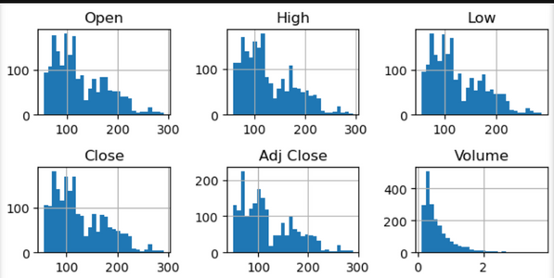

Exploratory Data Analysis (EDA)
Statistical Summary
Boxplots
Distribution Analysis
Price features show right-skewed distributions
Volume has a heavy-tailed distribution
Data is not normally distributed
Mean closing price ≈ 126.7
Minimum price ≈ 55.8
Maximum price ≈ 291.5
High standard deviation → indicates high volatility
Wide price range observed
Boxplots show presence of extreme values
Volume has very high variability
Price spread is wide, indicating market fluctuations

Slide 6
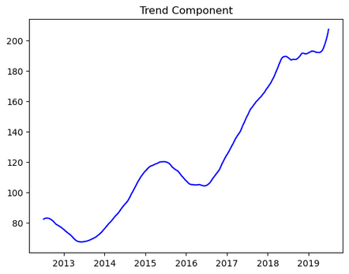
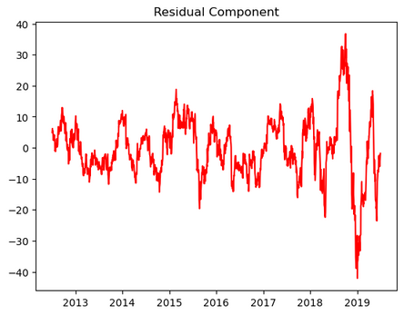
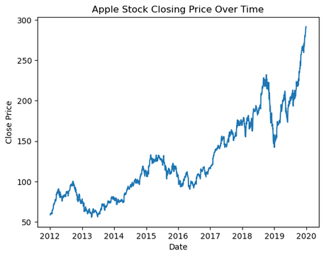
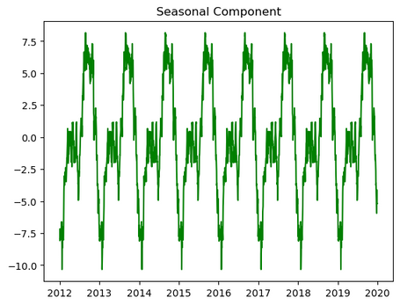
Exploratory Data Analysis (EDA)
Apple Stock Closing Price Over Time
Trend Component
Seasonal Component
Residual Component
Shows daily closing prices of Apple stock from 2012 to 2019.
A clear long-term upward trend is observed.
Several short-term fluctuations are visible.
Sudden spikes and drops indicate market volatility.
The series does not follow a constant mean → non-stationary behavior.
Represents repeating patterns in the data.
Shows periodic behavior across years.
Indicates that the stock exhibits seasonal movements.
Useful for understanding recurring market cycles
Represents the long-term movement of the stock price.
Smooth curve removes short-term noise.
Shows consistent growth after 2016.
Helps identify the overall direction of the market.
Represents random noise after removing trend and seasonality.
Contains sudden spikes and drops.
Shows unpredictable market behavior.
Indicates the presence of external and unexpected factors.

Slide 7

Feature Engineering
Why Feature Engineering?
In this project, feature engineering was performed to extract meaningful patterns from raw stock price data. Instead of using only the closing price, several time-based features were created to capture trend, momentum, and market variability. These features help the model understand both short-term and long-term price movements.
Moving Averages
Volatility
Moving averages were calculated over different day windows to smooth short-term fluctuations and highlight the overall trend in stock prices. This helps in reducing noise and capturing long-term movement.
Volatility was computed to measure the degree of variation in stock prices over time. It represents market uncertainty and risk, which is important for financial forecasting.
Lag Features
Returns
Lag features were created using previous day prices to help the model learn temporal dependency. These features allow the model to use past values to predict future prices.
Returns were calculated to measure the day-to-day percentage change in prices. This feature helps in capturing price momentum and rate of change.

Slide 8
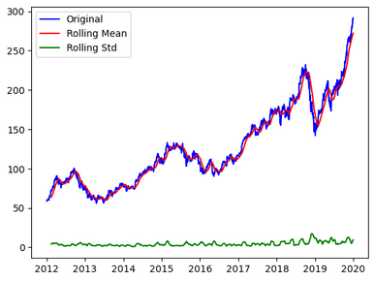
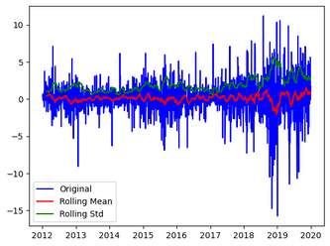
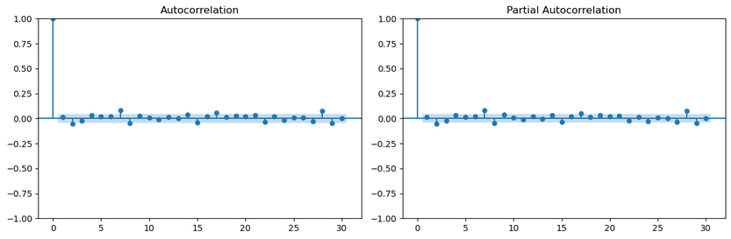
Stationarity & Time Series Diagnostics
Stationarity Analysis (Using Line Plot)
Augmented Dickey-Fuller (ADF) Test
The closing price line plot shows a clear upward trend over time.
The mean of the series changes continuously.
The magnitude of fluctuations increases in later years.
This indicates that the series does not have constant mean and variance.
Hence, the original time series is non-stationary.
Before Differencing:
Test Statistic = 1.219
p-value = 0.996
p-value > 0.05 → Fail to reject null hypothesis
The series is non-stationary
After Differencing:
Test Statistic = -13.63
p-value = 1.76e-25
p-value < 0.05 → Reject null hypothesis
The differenced series becomes stationary
After applying differencing, the trend is removed.
The differenced series fluctuates around a constant mean.
This suggests that differencing helps in making the series stationary.
Inference:
The ADF test statistically confirms what we observed in the line plot.
Differencing stabilizes the series.
This step helps determine the value of d (d=1).
ACF & PACF Analysis
ACF (Autocorrelation Function):
Most lags lie within the confidence interval.
No strong significant autocorrelations observed.
Indicates weak MA behavior.
Suggests q ≈ 0 or small.
PACF (Partial Autocorrelation Function):
No sharp cutoff at early lags.
All values lie near zero.
Indicates weak AR behavior.
Suggests p ≈ 0 or small.

Slide 9

Statistical Time Series Models
ARIMA
SARIMA
Captures linear relationships in time series.
Uses past values and past errors for forecasting.
Requires stationary data.
Extension of ARIMA with seasonal components.
Captures repeating seasonal patterns.
Suitable when seasonality is present.
Statistical Time Series Models
XGBoost
LSTM (Long Short-Term Memory)
A powerful gradient boosting algorithm.
Captures non-linear relationships.
Works well with engineered features like lag values and rolling statistics.
Requires supervised learning format.
Machine Learning / Deep Learning Models
A type of recurrent neural network.
Designed for sequence data.
Can learn long-term dependencies.
Suitable for non-stationary and non-linear patterns.

Slide 10
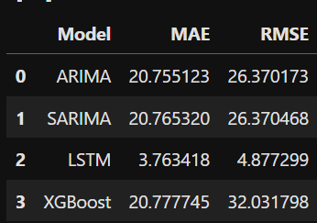
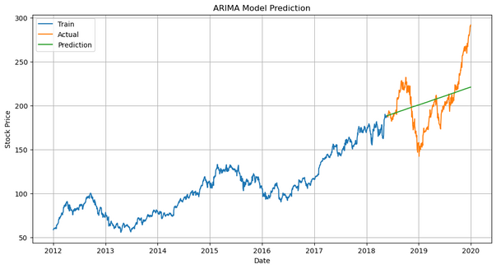
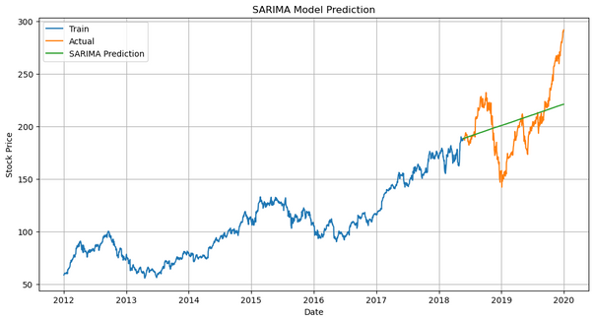
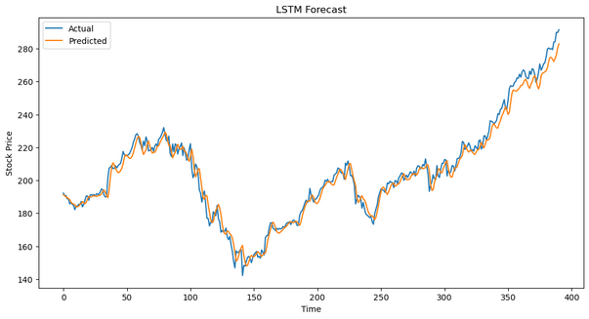
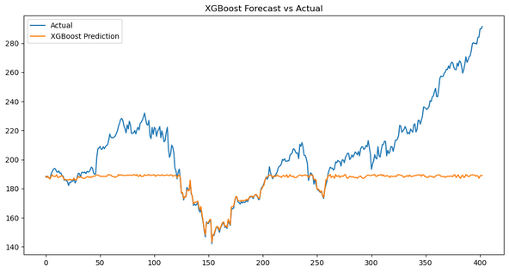
Model Comparison & Evaluation
Quantitative Comparison
Prediction
ARIMA
SARIMA
LSTM
XGBoost
ARIMA and SARIMA show similar performance.
XGBoost has higher RMSE, indicating weaker long-horizon accuracy.
LSTM significantly outperforms other models.
LSTM predictions follow the actual trend more closely.
ARIMA & SARIMA: Capture general trend but miss sharp variations.
XGBoost: Predictions remain relatively flat and do not follow market movements well.
LSTM: Closely tracks the actual price movements.

Slide 11
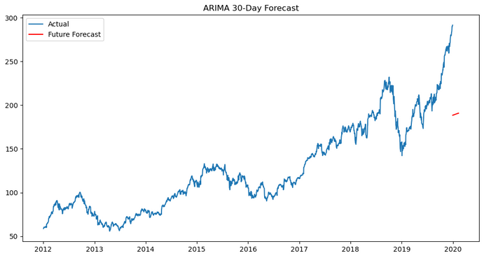

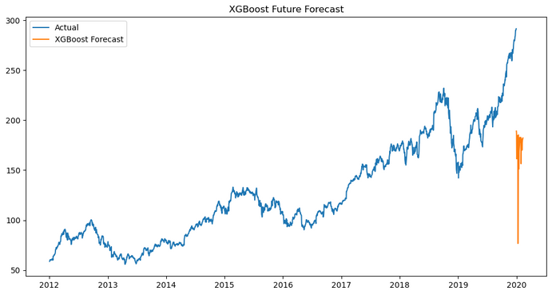
Future Forecast Comparison
(ARIMA, SARIMA, XGBoost)
ARIMA
SARIMA
XGBoost
Produces smooth forecasts.
Captures overall trend.
Fails to adapt to sudden price changes.
Limited in handling non-linear behavior.
Similar behavior to ARIMA with seasonal adjustment.
Captures repeating patterns ).
Still struggles with sharp fluctuations.
Produces smoother predictions.
Captures some non-linear relationships.
Forecasts tend to flatten over time.
Less responsive to recent market changes.
Does not preserve time continuity well.

Slide 12
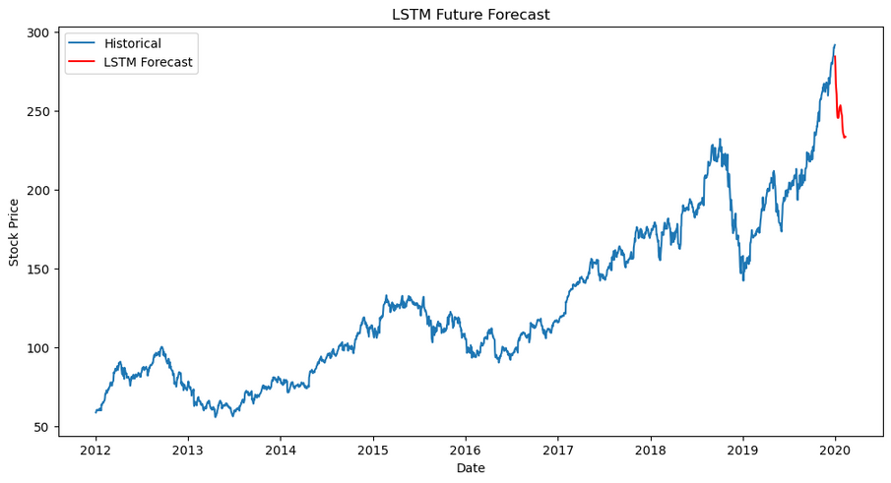
Final Future Forecast (LSTM) & Model Selection
Hyperparameter Tuning
Future Forecast (LSTM)
Different values of epochs, batch size, and number of LSTM units were tested.
The final configuration was selected based on validation performance.
Hyperparameter tuning improved prediction accuracy.
Final Model Selection
Evaluation Metrics (LSTM):
MAE: 3.76
RMSE: 4.88
Achieved the lowest error values among all models.
Captures both short-term fluctuations and long-term trends.
Handles non-linear and non-stationary patterns effectively.
Shows better generalization on unseen data.
Visually follows the actual price movement more closely.
Forecast follows the recent price trend.
Short-term fluctuations are preserved.
Transition from historical to future values is smooth.
No unrealistic spikes or sudden drops.

Slide 13
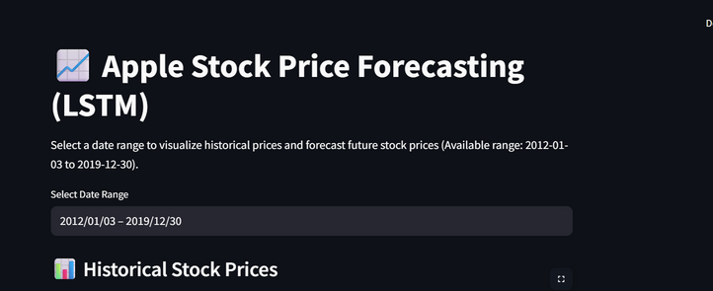
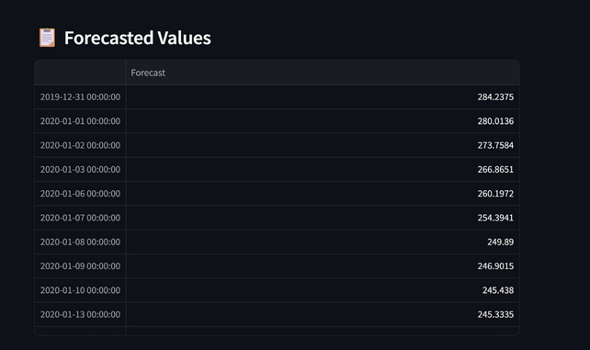
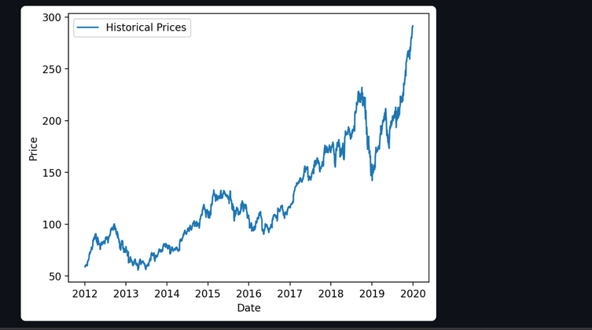
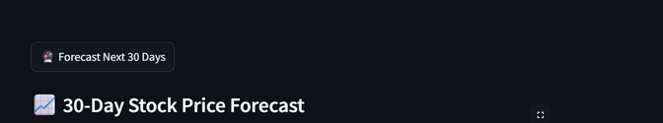
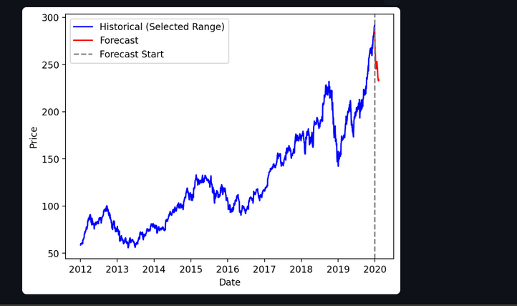
Deployment
Deployment Overview
The final LSTM model was deployed as a web-based interactive application.
The application allows users to select a date range and visualize historical Apple stock prices.
Users can generate a 30-day future forecast by clicking a button.
The deployed system provides both graphical and tabular forecast outputs.
Key Functionalities
Date range selection for historical visualization.
Dynamic plotting of selected historical prices.
Recursive multi-step forecasting for 30 days.
Inverse scaling to return predictions to original price scale.
Display of predicted values in a table.
Visual separation of historical and forecasted regions.
User Interaction Flow
Technologies Used
User selects a date range.
Historical prices are displayed.
User clicks “Forecast Next 30 Days”.
The model predicts future values recursively.
Forecasted prices are plotted and displayed in a table.
Frontend & UI: Streamlit
Backend: Python
Model: Trained LSTM model (.keras format)
Data Handling: Pandas, NumPy
Visualization: Matplotlib
Preprocessing: MinMaxScaler

Slide 14
Conclusion
Project Summary
Key Outcomes
This project focuses on forecasting Apple stock prices using historical time series data. The complete workflow of a data science project was followed, starting from data preprocessing and exploratory data analysis to feature engineering and stationarity analysis. Multiple forecasting models, including ARIMA, SARIMA, XGBoost, and LSTM, were implemented and evaluated using standard error metrics. Based on the comparative analysis, LSTM was selected as the final model due to its superior performance. The selected model was then used to generate a 30-day future forecast and was successfully deployed as an interactive web application, allowing users to visualize historical trends and future predictions.
Understood the behavior of stock price data, including trend, volatility, and non-stationarity.
Learned how time series data differs from regular tabular data.
Observed how different models behave on the same dataset.
Found that traditional models struggle with complex patterns.
Learned that deep learning models like LSTM handle temporal dependencies better.
LSTM achieved the best performance (MAE = 3.76, RMSE = 4.88).
Successfully generated a 30-day future forecast.
Gained experience in deploying a model as a web application.

Slide 15
Future Enhancements
Integrate real-time stock data using financial APIs.
Include external factors such as news sentiment, economic indicators, and global market trends.
Extend the forecasting horizon beyond 30 days.
Improve the user interface with advanced interactive visualizations.
Deploy the application on a cloud platform for wider accessibility.
Future Scope
Advanced Modeling
Experiment with hybrid models (e.g., ARIMA + LSTM).
Try attention-based and transformer-based models.
Use ensemble techniques for improved robustness.
Add uncertainty estimation for prediction confidence.

Slide 16

Thank You

